Slide 1

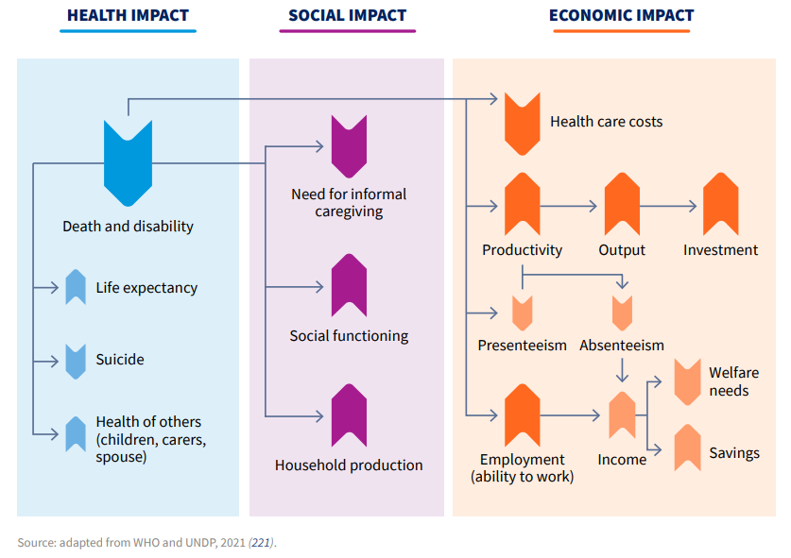
Mentale gezondheid raakt alles: gezondheid, samenleving en economie
World Health Organization (2022) World Mental Health Report

Slide 2
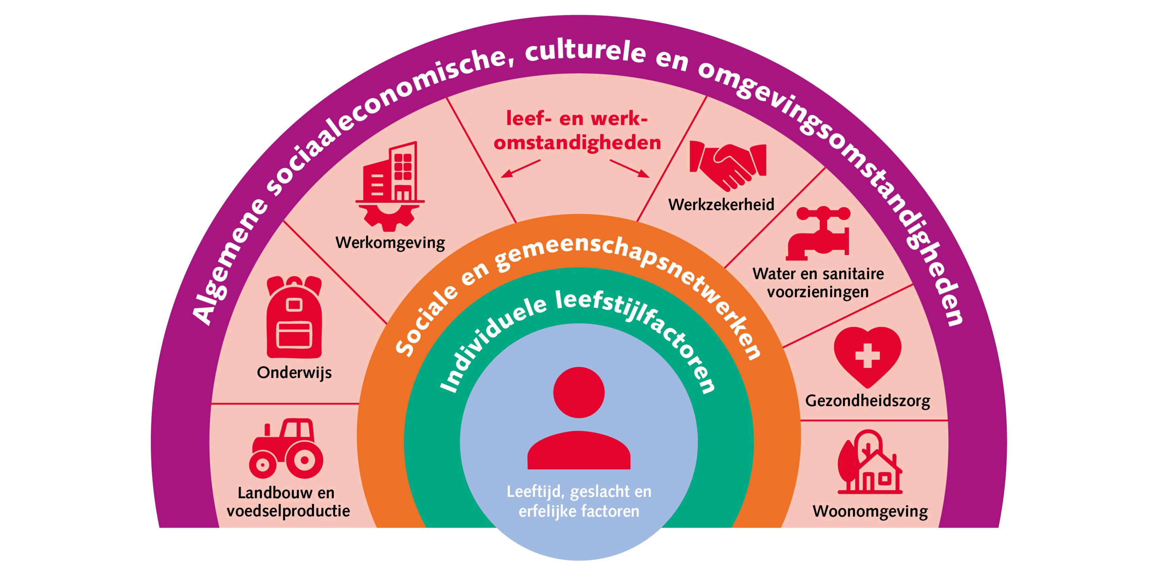
Hoe mentale gezondheid andere beleidsdoelen ondersteunt
Arbeidsparticipatie blijft stabieler, hogere productiviteit, minder verzuim
Gezondere werknemers
Beter fysieke gezondheid, kwaliteit van leven, minder zorgkosten
Leerprestaties verbeteren
Meer contact/verbinding, sociale cohesie

Slide 3
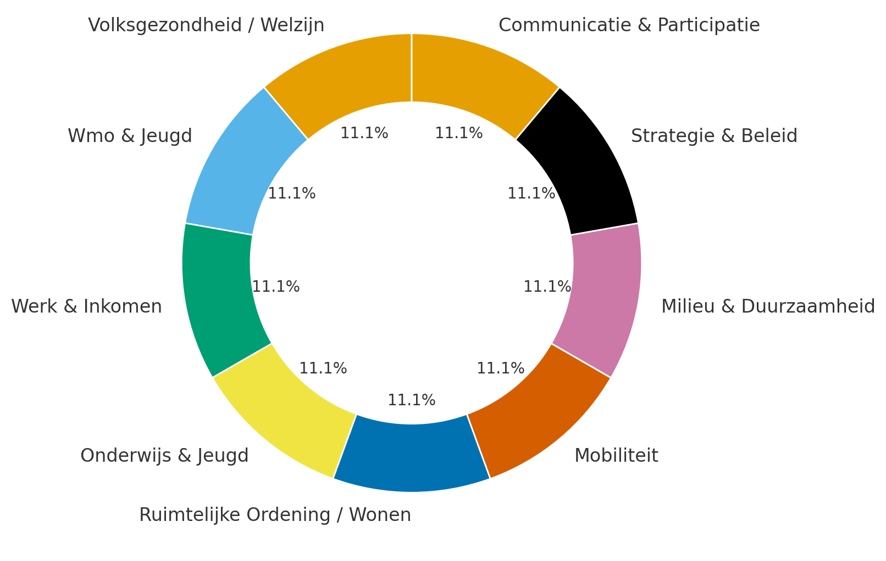










Slide 4
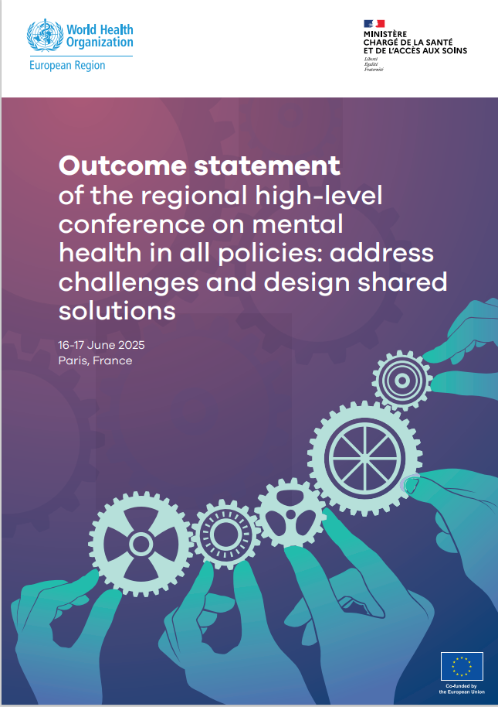
Mental Health in All Policies from silos to solutions: lessons from the European region
Dr Ledia Lazëri
Regional Adviser for Mental Health
WHO Regional Office for Europe

Slide 5



Addressing mental health challenges in the
27 EU Member States, Iceland and Norway

Slide 6
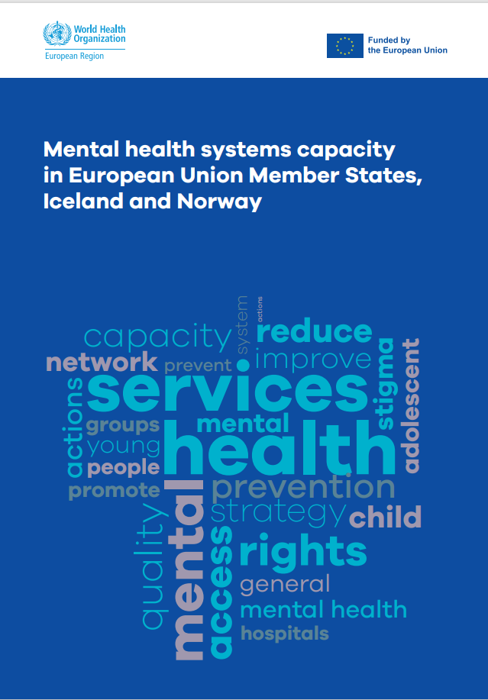
Understanding priorities, exploring barriers, promoting enablers

Slide 7
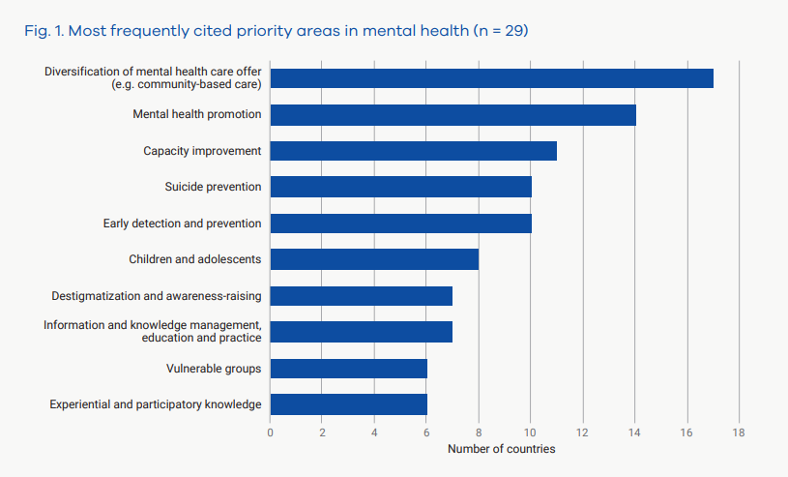
Understanding priorities, exploring barriers, promoting enablers

Slide 8
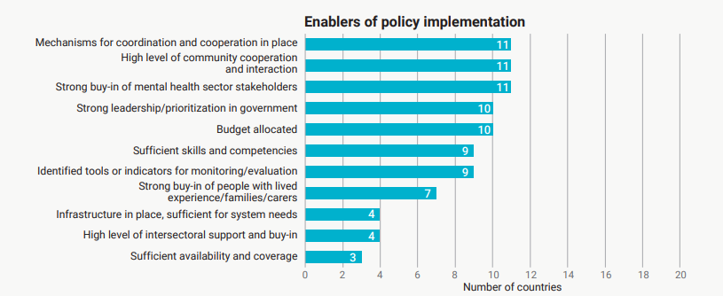
Understanding priorities, exploring barriers, promoting enablers

Slide 9
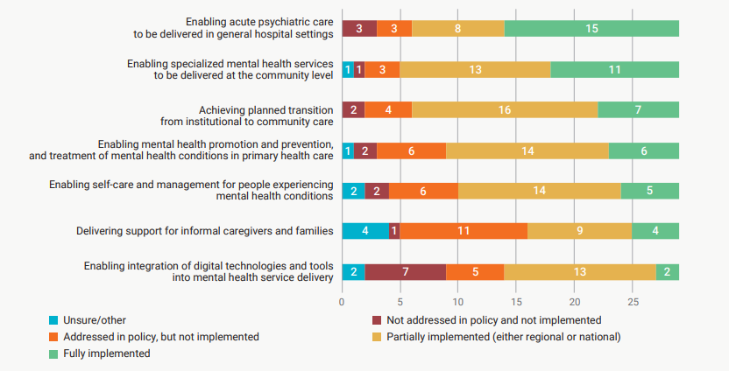
Implementation of policies in key areas of mental health service delivery

Slide 10
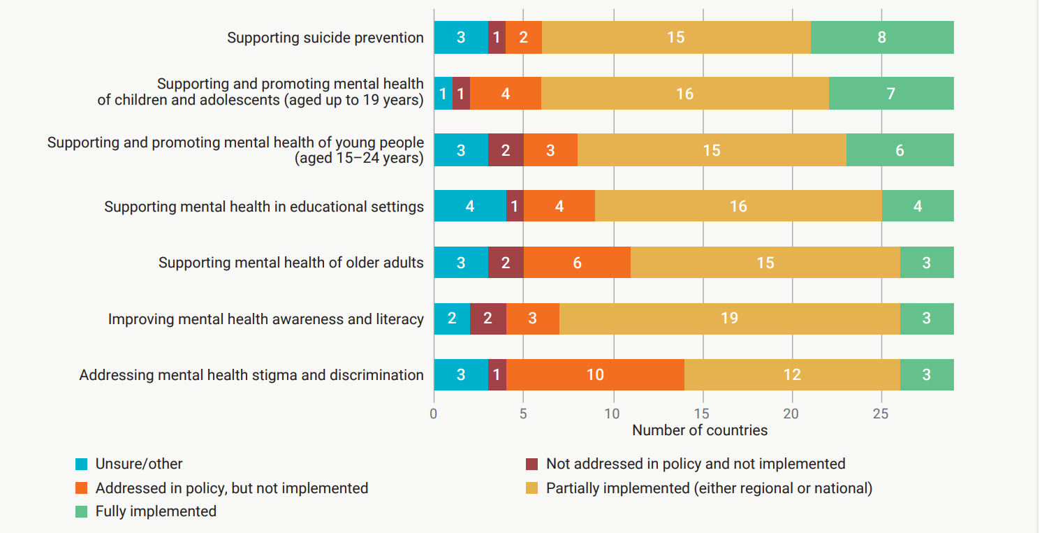
Implementation status of policies in key areas for mental health promotion/prevention and resilience over the life course

Slide 11

TWO KEY THEMES EMERGING
Embedding mental health in all policies ​
All 22 countries emphasized the need to integrate mental health into policies and planning of all sectors—from education and employment to transport and housing.​
Transforming mental health systems​
Ten countries expressed clear interest in receiving support for transforming their mental health systems, highlighting widespread recognition of necessity for fundamental changes in how mental health care is organized, delivered, and financed.​
Evidence on Policy
Survey on Mental Health Systems Capacity
Country profiles
Policy dialogues
22 Countries
200+ stakeholders
Convene countries for a multi-sectoral dialogue
The Paris High Level meeting on MHiAP, June 2025

Slide 12
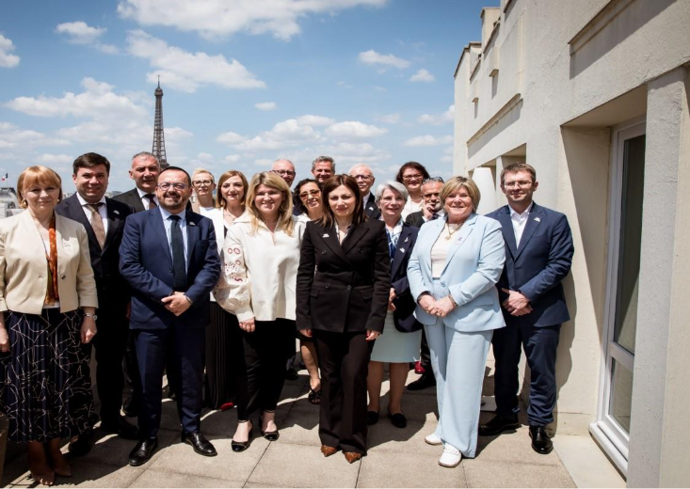
What happened in Paris
260+ participants from 31 countries
30 persons with lived experience of mental health conditions
20 high-level officials (ministers, deputy ministers, state secretaries)
Diverse sectors e.g. education, youth, agriculture, employment, justice, housing, urban planning, transport, innovation and digital technology
Co-organized with French Ministry of Health and Access to Care, in partnership with WHO Collaborating Centre in Lille

Slide 13
What did we hear
Central challenge not lack of policy, but deficit in cross-sectoral governance mechanisms required to translate policy into practice.
Local action identified as primary engine of innovation - local governments pioneering integrated, community-based approaches.
Central focus on social and structural determinants—such as housing, employment, and education
Imperative of life-course approach - tailored interventions for key populations e.g. rural areas, farmers facing high suicide rates, populations affected by conflict

Slide 14

Outcome statement
Conference called for strong intersectoral collaboration to promote mental health and well-being as integral to social resilience
Participants committed to embedding mental health considerations across all areas of government (e.g. education, housing) through coordinated funding, inclusive community initiatives and involvement of people with lived experience.
Statement emphasizes rights-based, prevention-focused approaches, improved access to services, safe digital environments, adherence to UN conventions, supported by national coordination teams and multisectoral advisory bodies to ensure accountability and shared progress.

Slide 15



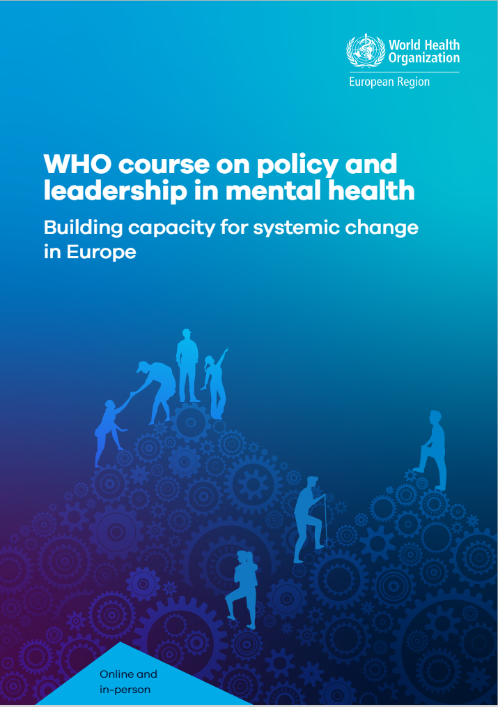

Evidence on Policy
Survey on Mental Health Systems Capacity
Country profiles
Policy dialogues
22 Countries
200+ stakeholders
Multi-sector
Paris conference (June 2025)
31 countries
13 sectors and 30 PWLE
Action
Leadership training
Capacity-building
Advocacy
Data and digital
2023
2024
2025
2026

